Slide 1
Project Status Report
Team D
Sai Bharadwaj Mukkera
Nithin Reddy Aenugu
Purna Sai Kumar Cheedirala
Tejas Manu Srinivasan
Shreeya Krishna Shiva
12-03-2024, 6:15pm https://github.com/tejas-manu/fox-of-hood

Slide 2
Project Info
Project roles and management:
Team Members and their roles:
Tejas Manu Srinivasan – Dashboard UI, Admin Panel and components integration
Sai Bharadwaj Mukkera – Login UI, Transaction History and Database Integration
Nithin Reddy Aenugu – API, Buy/Sell component and its integration
Purna Sai Kumar Cheedirala – Portfolio management component, Profile Component
Shreeya Krishna Shiva – Database setup, management and integration. Logging
Meeting plan:
Twice a week online
Once in-person
Tool used to communicate and assign task:
Zoom/Google meet – for status update calls
Asana – for task allocation (Project Management)

Slide 3
Project Info
Development Process:
Development Process used: Agile
Project is being developed in phases (sprints). After every phase there is a feedback and improvements made.
Project is divided into multiple sprints with their respective milestones.
Adjustments made to the features such as which API to use and so on.
Tools used:
Development:
ReactJS
Node.js
PostgreSQL
Version Control:
GitHub
API:
Alpha Vantage

Slide 4
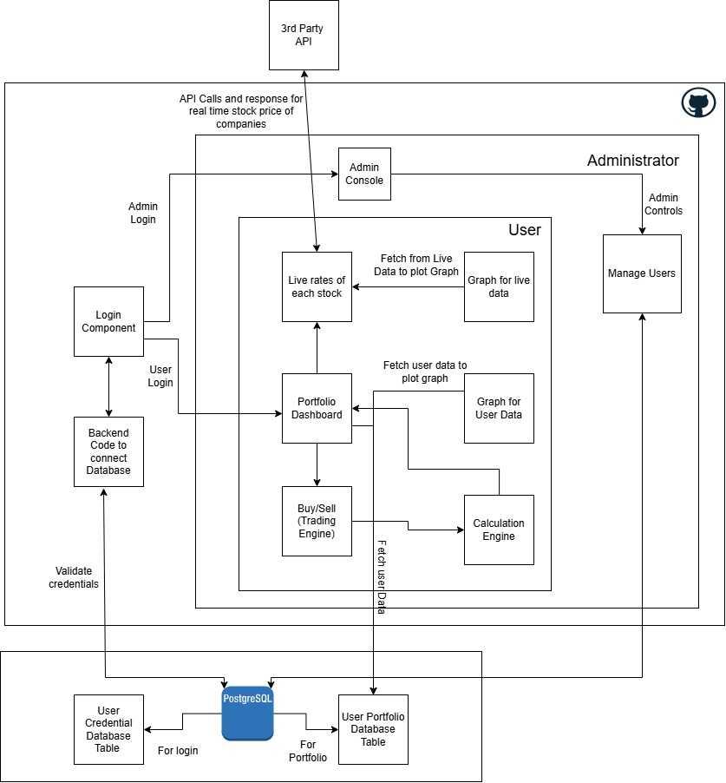
Architecture Diagram
Key Components in the Architecture diagram:
Database and schema
Connection between various components and the database
Calculation engine to quickly update the changes on the Dashboard

Slide 5
Requirement Traceability
Requirement Number: 3.3
Requirement : Portfolio Management
Users logged in will be able to view their wallet balance, invested amount and profit/loss.
Users will be able to view the price of stock when it was purchased and its current value.
Provides Profit/Loss based on the user’s current holdings.
Enables user to buy/sell stocks.
The architecture internals which handle this requirement is:
Portfolio Page
Buy/Sell Engine
Calculation Engine
Backend code to connect Database
PostgreSQL

Slide 6
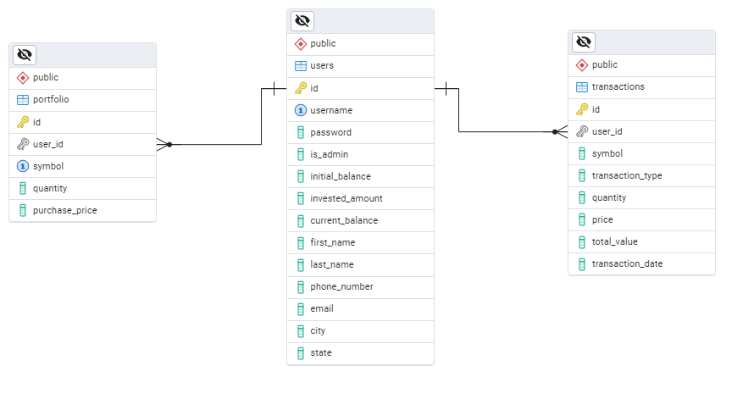
ER Diagram for Portfolio and user management table

Slide 7
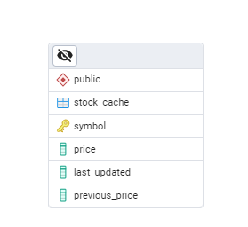
ER Diagram for Stock market Cache Table

Slide 8
Accomplished Work
Work Accomplished so far:
Portfolio Page where the user can visualize and maintain their stocks.
Buy/Sell page where the user can trade new stocks.
Transaction history for the users to have a log of their trades.
Admin Panel for Administrator to manage users.
How good is it:
Satisfactory, was able to cover all the given requirements
UI design implemented as expected.
Trading Engine and Calculation engine works efficiently

Slide 9
Accomplished Work
How Big:
Divided into 8 major components.
8hrs a week per person.
Approx. 2200 lines of code
Apart from the 8 components, there is a backend component and DB Schema.
Language used, platforms and compatibility:
Frontend – ReactJS
Backend integration with DB – NodeJS
Database – postgreSQL
Platforms – Any web browser
Compatibility – compatible with most laptops and desktops

Slide 10
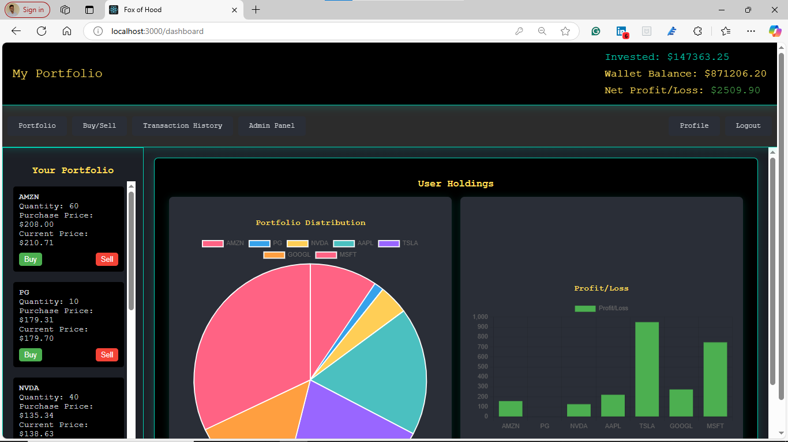
Software In Action
3 Key Features:
Portfolio Overview
Trading Component
Admin and Transaction History

Slide 11
Lessons Learned
What went right ?
Achieved most of the requirements.
UI Implementation was done as expected.
What went wrong ?
Got the API requirement wrong initially.
Did not follow a systematic approach when it comes to which component to do first.
What would we do differently ?
Start implementation early.
Creating a pipeline and develop components in a particular order. (basic to complex)

Slide 12
DEMO

